Slide 1
National Competitiveness
Dr. Kwangsoo Kim
Konkuk University

Slide 2
WHAT IS COMPETITIVENESS?
Competitiveness comes from the productivity / innovation for which a nation uses its human, capital, knowledge, and natural resources.
- Productivity & innovation sets the sustainable standard of living
(prosperity: wages, returns on capital, etc.) that a country can sustain
- It is not what industries a nation competes in that matters for prosperity
but how productively and innovatively it competes in those industries
- Productivity and innovation arise primarily from firms/industries
Hence, nations compete to offer the most productive and innovative environment for firms/industries

Slide 3
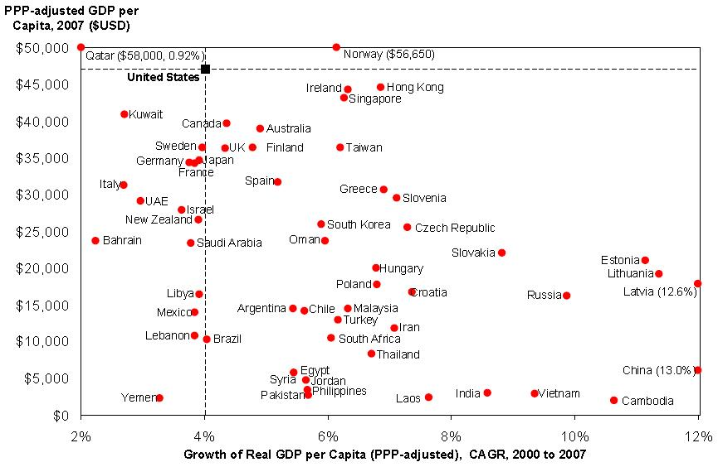
Prosperity Performance
Selected Countries
Source: EIU (2009)

Slide 4
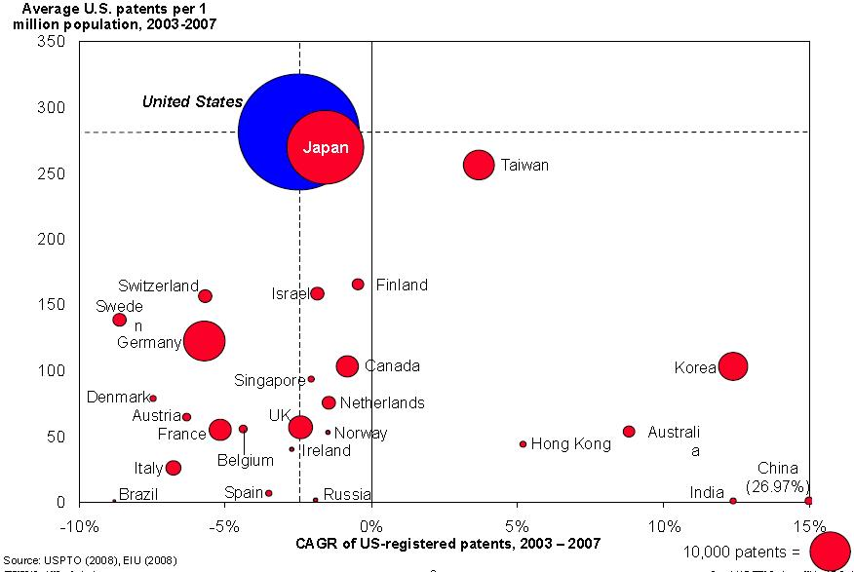
Innovative Capacity Innovation Output of Top 25 Patent Producing Countries
Source: USPTO (2008)

Slide 5
DETERMINANTS OF COMPETITIVENESS
Microeconomic Competitiveness
Quality of the
National
Business
Environment
State of Cluster
Development
Macroeconomic Competitiveness
Social
Infrastructure and
Political Institutions
Macroeconomic
Policies
Macroeconomic competitiveness creates the potential for high
productivity and innovation, but is not sufficient
Productivity and innovation ultimately depend on improving the
microeconomic capability of the economy and the sophistication of
local competition at the industry level

Slide 6
Macroeconomic Competitiveness
Social Infrastructure and Political Institutions
Human development:
- basic education and health care
Rule of law:
- property rights and due process
Political institutions:
- stable and effective political and
governmental processes and
organizations
Macroeconomic Policies
Fiscal policy:
- public spending aligned with
revenues over time
Monetary policy:
- low levels of inflation
Macroeconomic management:
- avoiding structural imbalances
and cyclical overheating

Slide 7
Microeconomic Competitiveness: Quality of the National Business Environment
Context for
Firm
Strategy
and Rivalry
Local rules and incentives that encourage
investment and productivity
- e.g. salaries, incentives for capital investments,
intellectual property protection, corporate
governance standards
Vigorous local competition
- Openness to foreign competition
- Competition laws
Factor
(Input)
Conditions
Demand
Conditions
Access to high quality
business inputs
- Natural endowments
- Human resources (labor)
- Capital availability
- Physical infrastructure
- Administrative and information
infrastructure
- Scientific and technological infrastructure
Sophistication of local
customers and needs
- e.g., Strict quality, safety, and
environmental standards
- Consumer protection laws
Related and
Supporting
Industries
Availability of suppliers and supporting
industries
Many things matter for competitiveness
Successful economic development is a process of successive upgrading, in which the business
environment improves to enable increasingly sophisticated ways of competing

Slide 8
Microeconomic Competitiveness:
State of Cluster Development
Tourism Cluster in Cairns, Australia
Public Relations
& Market
Research Services
Travel agents
Tour operators
Local retail,
health care, And
other services
Food
Suppliers
Local
Transportation
Restaurants
Attractions and
Activities
e.g., theme parks,
casinos, sports
Property
Services
Souvenirs,
Duty Free
Hotels
Airlines,
Cruise Ships
Maintenance
Services
Banks,
Foreign
Exchange
Government Agencies
e.g. Australian Tourism
Commission, Great Barrier
Reef Authority
Educational Institutions
e.g. James Cook University,
Cairns College of TAFE
Industry Groups
e.g. Queensland Tourism
Industry Council
Sources: Michael Porter, 2009 (HBS student team research )

Slide 9
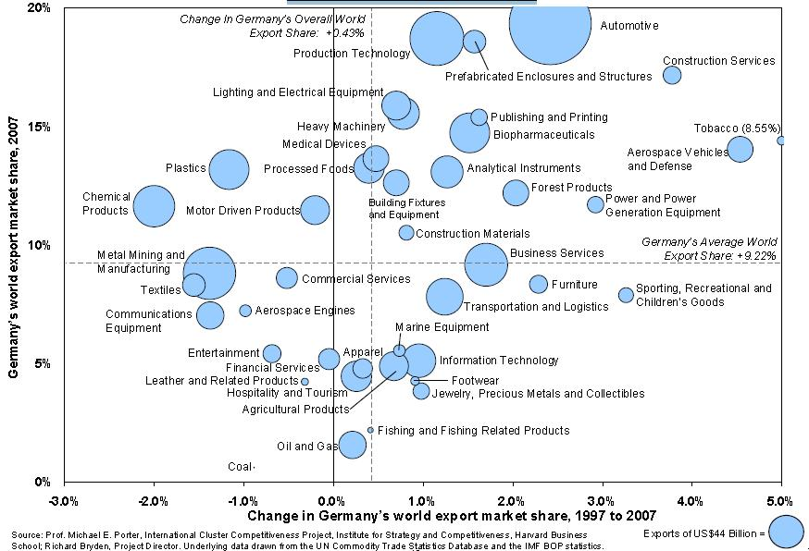
National Cluster Export Portfolio
Germany, 1997 to 2007
Source: Michael Porter, International Cluster Competitiveness Project, 2009

Slide 10
Role of Government for Competitiveness
To help firms achieve productivity & innovation
Focus on specialized factor creation
Enforce strict product, safety, and environmental standards
Sharply limit direct cooperation among industry rivals
Promote goals that lead to sustained investment in human skills, innovation, and physical assets
Deregulate competition
Enforce strong domestic antitrust policies
Reject managed trade

Slide 11
Role of Private Sector/Company for Competitiveness
Create pressures for innovation
Welcome domestic rivalry
Take an active role in upgrading local infrastructure
Improve the local business environment (the national diamond), and
nurture local suppliers first and attract foreign suppliers.
Globalize to tap selective advantages in other nations – abandoning
the home diamond is not good
Locate the home base to support competitive advantage
Work closely with local educational and research institutions to
upgrade their quality and create specialized programs addressing the
cluster’s needs
Inform government on regulatory issues and constraints bearing on
cluster development

Slide 12
CONCLUSIONS
National competitiveness should be understood at the level of industry
National competitiveness is determined by macroeconomic and microeconomic factors.
Especially the quality of the national business environment(i.e., factor conditions, demand conditions, context for firm strategy and rivalry, and related and supporting industries) and the state of cluster development are critical for national competitiveness

Slide 13
CONCLUSIONS
Companies are the only real entities that can achieve and sustain competitive advantage (competitiveness), and they can do so by improving productivity and innovation
Governments can help companies achieve competitiveness by providing them with more productive and innovative business environments
Managers should understand national competitiveness for effective global business management

